Slide 1


Slide 2


What is the GAA Green Clubs Programme?
A partnership between GAA, LGFA, Camogie Association & local government
Promoting sustainability awareness and engagement among Gaelic Games family membership
Supporting clubs in the greening of club operations, facilities management and infrastructure planning
Fostering links between clubs and community through shared sustainability projects
Weaving environmental awareness into the GAA's strong sense of community and place

Slide 3
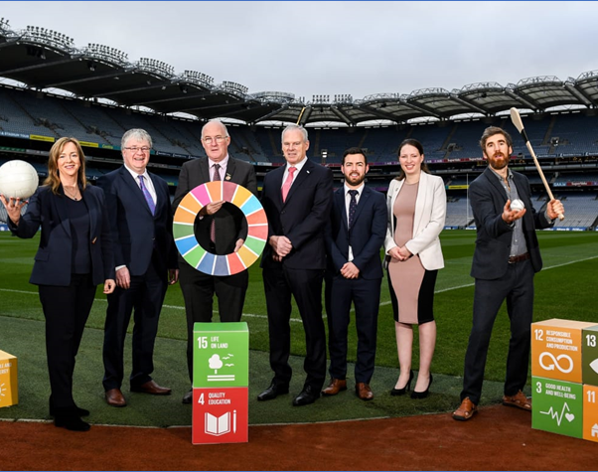





Origins & Background
Both the GAA and Carlow County Council were named Sustainable Development Goal (SDG) Champions by the Department of Communications, Climate Action & Environment in 2019
This led to discussions between the GAA and local authority Climate Action Regional Offices (CAROs)
In January 2020, the GAA signed a Memorandum of Understanding with the County & City Management Association (CCMA), the representative group for local authority management in Ireland
The CCMA & CAROs helped the GAA to engage with expert partners in Energy, Water, Waste, Biodiversity & Transport

Slide 4
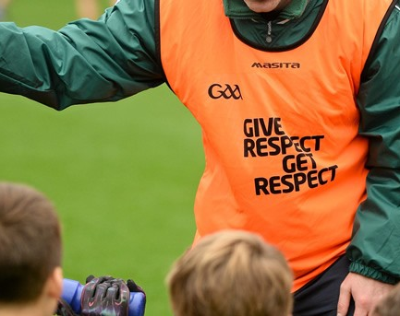
Why is the GAA going Green?
Because we were asked
  Clubs asking for guidance
  Clubs wanting to share success stories
  Positive responses to Green Club Questionnaire issued in March 2020
Because it makes sense
  Green planning benefits a club’s Financial & Operational Sustainability
  It has the potential to strengthen Club & Community Engagement
  Green action and awareness contributes to well-being & sense of place
Because it's the right thing to do
  GAA Values – Respect, Community, Teamwork

Slide 5

GAA Green Club Programme - Phase 1
5 Themes – Energy, Waste, Water, Biodiversity & Transport
12 months
45 Clubs from 17 Counties across the whole Island
Includes Regional Grounds – O'Moore Park, Portlaoise and Connacht Centre, Bekan
Officially launched Weds Dec 9th @7pm

Slide 6
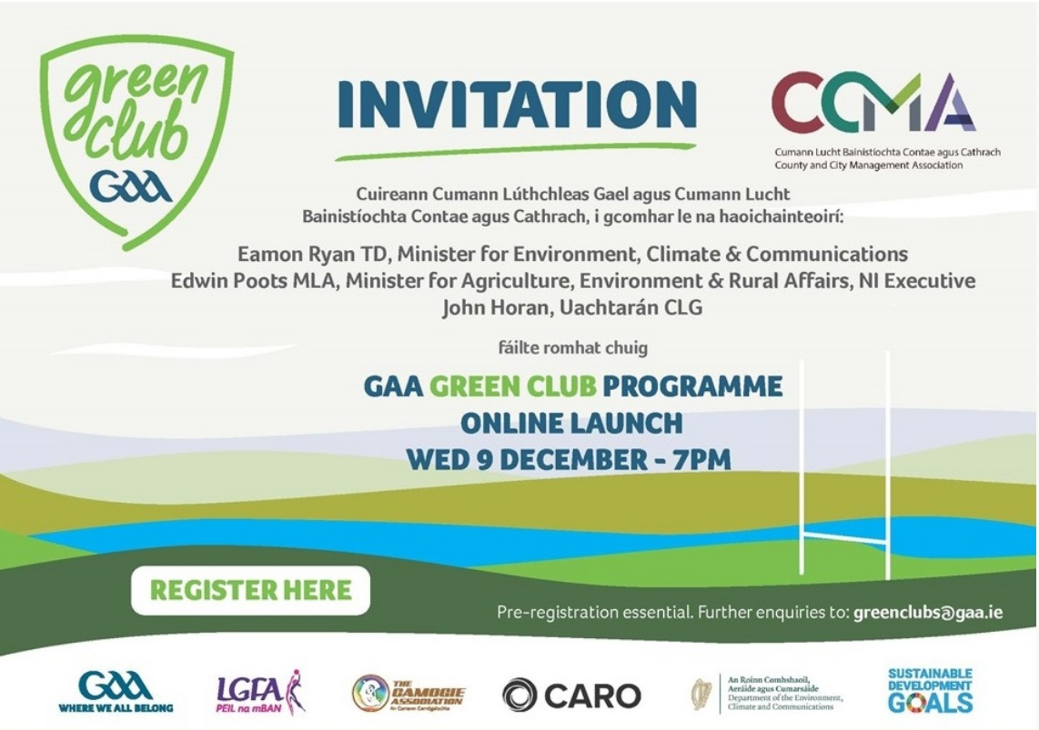

Slide 7

What do we want to achieve?
Mainstreaming sustainability concerns into GAA planning and practice, at club, regional and national level
Ensuring consistency of green messaging across home, school, workplace, club, community
Helping clubs exchange experience and best practice
Raising awareness of projects and possibilities through Green Club publications and messaging
Promoting pride in community and natural heritage

Slide 8
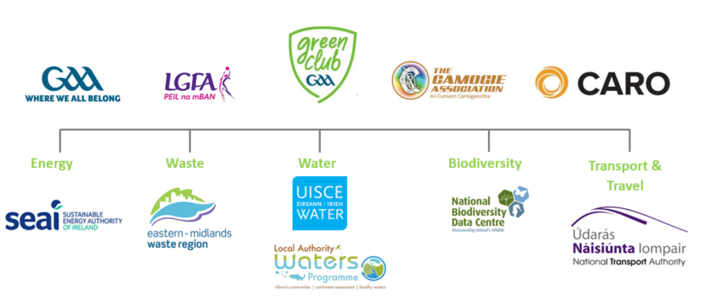
Structures & Partners
Partnership Structure

Slide 9










An All-Island Programme
There are two Ulster GAA sub-groups within the seven subgroups of the Green Club first phase
These are taking a cross-cutting approach to the five Green Club thematic areas
The GAA Green Club is collaborating with environmental organisations in the North to support and guide the clubs
Donegal County Council and Derry-City and Strabane District Council have partnered with the GAA Green Club programme to develop a cross-border, North West Green Club hub

Slide 10

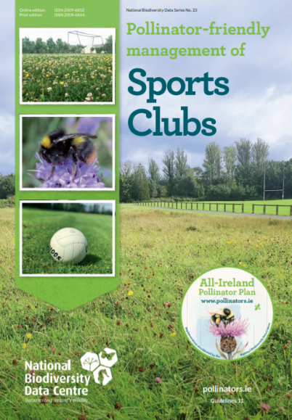
How are we doing it?
Pilot programme – 45 clubs
Clubs carry out baseline audits/surveys to establish a starting point
Expert Partners support clubs in Identification & Implementation of actions
Clubs give feedback on usefulness of existing resources and guidance
Expert Partners develop new resources and guidance to meet the needs
of volunteer clubs
Practical case studies to be developed to encourage and guide other clubs
Access to relevant funding streams promoted and supported
Findings to feed into GAA policy & guidance – e.g. development of sustainable pitch management guidelines

Slide 11
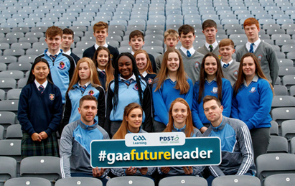
Youth Engagement & Education
Development of Green Club Youth Engagement Structures
  Encouraging Youth Involvement on Green Team and in Green Club activities
  Promoting connections with Green Schools
  Linking with GAA youth programmes, including the Future Leaders Transition Year Programme and the Dermot Earley Youth Leadership Initiative
Collaboration with national youth fora
Developing educational interventions for Club, Post-Primary and Primary, based on Green Club aims and content
  Linked to the Curriculum
  Applied
  Action Oriented
  Grounded in Place
  Built with the Experts and the Learners

Slide 12
Milestones
Club Executive
Club
Green Team
Audit
Community
Consultation
Green Club Charter
Club
Plan
1
2
3
4
5
6
FEBRUARY
APRIL

Slide 13

A Green Club Framework

Slide 14

A Green Club Framework
    Acknowledge – Measures, Structures and Actions already in place
    Achieve –
    Learn, Introduce, Reduce, Communicate

Slide 15

A Green Club Framework
    Pick –
    Actions to be Undertaken
    Plot –
    Timelines and Targets

Slide 16

A Green Club Framework
    Identify –
    Existing partnerships (internal and external) and expertise within club.
    Engage –
    Partnerships that need to be developed to implement plan – within the club and beyond

Slide 17

A Green Club Framework
    Reflect –
    Assess the benefits for club and community
    Review –
    Identify challenges encountered and recommendations for change/improvement

Slide 18
Ulster GAA Clubs – Priority Areas & Potential Actions
Neighbours in Nature
Learn – focus on plant, insect or animal species native to club area
Actions to encourage (e.g. habitat creation, planting)
Greening our Clubhouse
Energy management
Water conservation
Greening our Walkway
Litter
Greening our Games
Transport
Single-use items
Communicate (Workshop, signage, walkway benches
Actions to protect (e.g. litter pick, waste management, water quality, carbon/emissions, mowing schedule, pitch management)
Waste Management
Communication and Signage
e.g.
Changing Rooms (Energy & Water)
Match-day waste
Gear and equipment
Waste
Communications – e.g. signage, benches, workshops
Biodiversity
Water heritage

Slide 19






Slide 20








Slide 21


Slide 22


Slide 23


Slide 24


Slide 25


Slide 26
Support Structures
Ongoing access to Sub-Group GAA lead
Regularly monitored Green Club email – greenclubs@gaa.ie
Green Club Webpage – www.gaa.ie/greenclub
Green Club Facebook Closed Group
GAA Learning Platform Green Club Zone
Sub-Group Meeting – Early March

